Slide 1
Assessing Bitcoin as an Asset Class
By. Alexander Bogdanowicz

Slide 2
What is Bitcoin? And Who’s Asking?
Is it a store of value? (Gold) (Bonds)
Is it simply a speculative instrument (volatility play)?
Is it an actual currency? (EUR, USD)
Government’s may ask: Will it destabilize global currency markets and monetary policy?
Financial Institutions may ask: Will it cut out the financial intermediary in most transactions?
I’m asking: What does the market think it is?

Slide 3
I’m asking: What does the market think it is?
Specifically: I want to compare and contrast Bitcoin against asset classes (Stocks, Commodities, Currency, Debt Instruments)

Slide 4
Dataset
Asset Class | Data | Features | Source | Date-Range
Stocks/Shares in Publicly Traded Companies | S&P 500 (SNP) | Price, Trade Volume | Yahoo Finance | 2004-11-19 to 2019-04-18
Commodities (Gold) | SPDR Gold Shares (GLD) | Price, Trade Volume | Yahoo Finance
Currencies (FOREX) | EUR/USD & USD/JPY | Price, Trade Volume | Dukascopy Currency Database
Corporate Debt | iShares iBoxx Investment Grade Corporate Bond ETF (LQD) | Price, Trade Volume | Yahoo Finance
Risk Free bonds | iShares 7-10 Year Treasury | Price, Trade Volume | Yahoo Finance
Cryptocurrencies (BTC) | Bitcoin USD (BTC-USD) | Price, Trade Volume | Yahoo Finance | 2010-07-16 to 2019-04-18

Slide 5
Outline for Analysis
Create a Feature to model Asset Variance
Utilizing ARIMA/GARCH
Create a Support Vector Machine
Goal is to Predict the Direction of Returns (+1,-1)
Create an ANN Classifier
Goal is to Predict with reasonable accuracy what bucket an asset falls into based on specific features

Slide 6
Creating a new feature with ARIMA
ARIMA stands for Auto-Regressive Integrated Moving Average
Used in Time Series Analysis when a time series displays certain Auto-Regressive tendencies
Can be broken down into two components:
Auto-Regressive (AR) Model
Time Series that is regressed on lagged instances of itself
Moving-Average (MA) Model
Time Series Forecast Errors regressed on lagged instances of itself
Integrated Component:
Method of making the series “Stationary”
How do we know what to do?

Slide 7
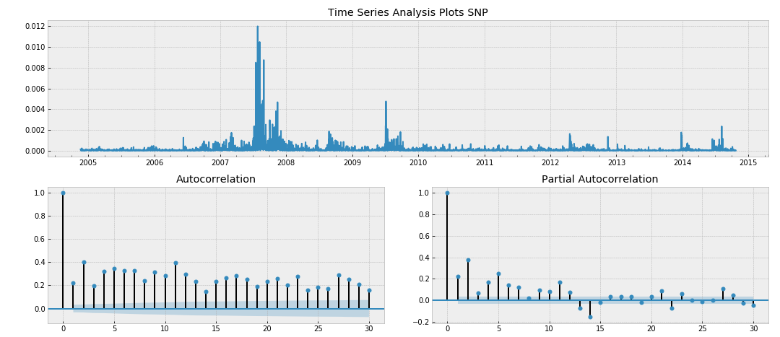
Start with ARIMA/GARCH
We decide our ARIMA parameters via the Auto and Partial-Autocorrelation Plots, and use the residuals from this model as a proxy for model variance

Slide 8
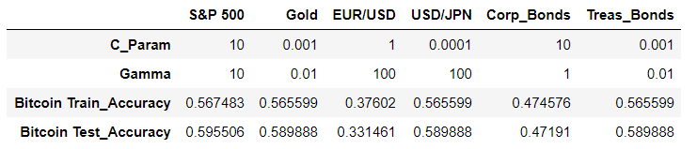
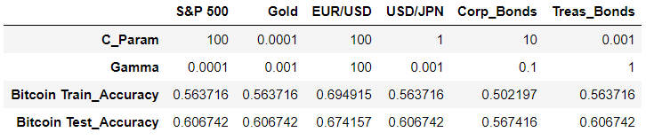
Creating a Support Vector Machine
Goal: Train an SVM Directional Classifier to forecast the direction of price movement 1-month out for each Asset Class in the Dataset and asses the utility of our ARIMA residuals
Test each SVM on unseen Bitcoin price volatility, momentum (model1) and residuals (model 2)
The best classifier will likely have the closest relationship to Bitcoin as an Asset Class
W/O Residual
With ARIMA Residuals

Slide 9
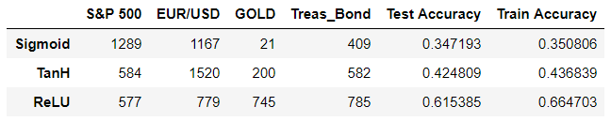
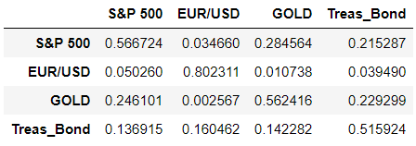

Creating a Neural Net Classifier
Goal: Take advantage of the flexibility of the input and output space to create an asset classifier with an input size of 60 (20-days of Logged Prices, Traded Volume, and ARIMA Residuals) and output size of 4 (Share, Gold, Curr, Com)

Slide 10
Interesting Findings?

